Slide 1
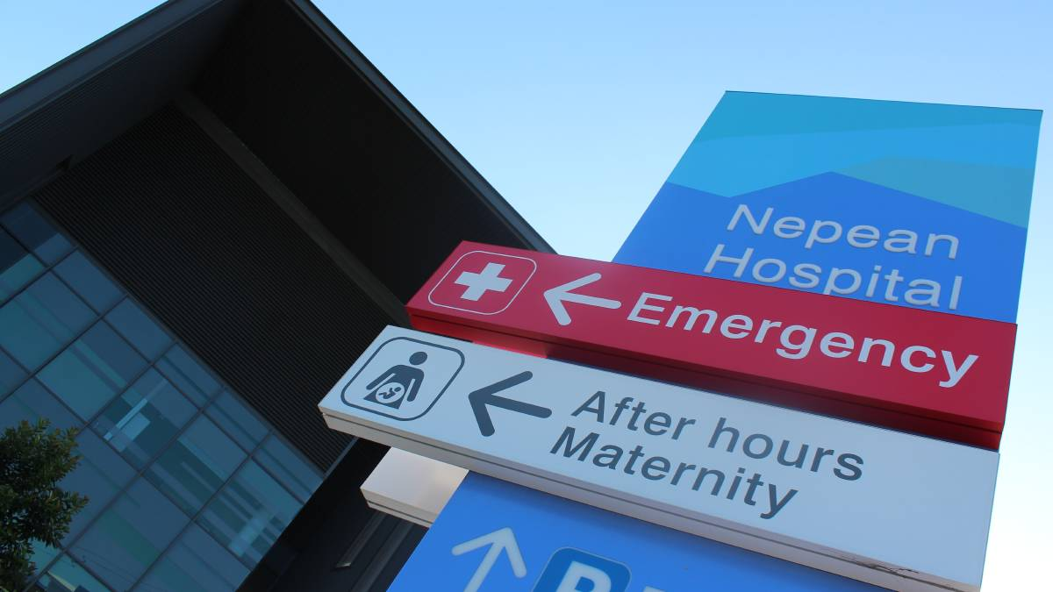
Amputee Care Standards
The Nepean Experience
2019
Sanzida Hoque – Sanzida.Hoque@health.nsw.gov.au Michelle Wykes – Michelle.Wykes@health.nsw.gov.au

Slide 2
Aim: “Peer Learning”
Identify key themes across sites where facilities are not meeting the ACI Care Standards
Current care pathways of other facilities
Strategies for overcoming challenges and change management

Slide 3
Overview
Minimum Standards: Care of the Person Following Amputation
Data from ACI workshop
Nepean Process
Nepean Data
5 minute activity
Implementation/Brian-storming
Identify Key Standards

Slide 4
Minimum Care Standards
Background
ACI Workshop
Changes from previous Care Standards
Amputee care standards NSW (2008)
Minimum Standards of Care of the person following Amputation (2017)

Slide 5
Data from ACI

Slide 7
Nepean Process
Feedback to the Amputee MDT re. ACI Workshop
MDT reviewed Care Standards
Key team members completed Self-Assessment forms
Data was collected and collated
Key areas for change identified to meet care standards
Meet with MDT to work out change process and engagement of key stakeholders
Implementation of change process
Re-evaluation

Slide 8
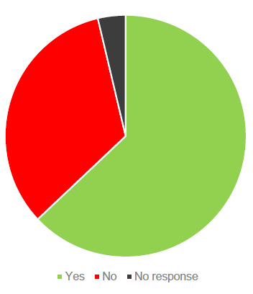
ACI Responders (54)
Awareness of the Standards

Slide 10
S1: Care is coordinated, multispecialty and interdisciplinary across all phases

Slide 11
S2: A comprehensive care plan is developed and updated throughout the care journey

Slide 12
S3: Counselling and psychological support is available across all stages of care

Slide 13
S4: Referral is offered to a managed peer support program

Slide 14
S5: Falls prevention and falls safety education is provided

Slide 15
S6: Discharge planning and transfer of care arrangements occur with communication between all key stakeholders

Slide 16
P1: Care of the residual limb and management of risk factors for further amputation are addressed

Slide 17
P2: Education occurs across all stages of care

Slide 18
P3: Pain is assessed, managed and monitored across all stages of care

Slide 19
P4: Special consideration is given to the needs of specific populations

Slide 20
Feedback from Nepean Self-Assessment Tool
-Large number of responses of ‘sometimes/irregular/partially’ in many areas.
-Often completed on an adhoc basis and not documented clearly.
Key Areas for Improvement:
- Education (documentation/ person responsible)
- Peer Support (documentation/ person responsible)
Pre surgical input/ assessment
Use of RRD (timeframe/ consistency)

Slide 21
Activity:
Each clinician to consider the following questions:
What is working well in your facility?
What are the opportunities for improvement?
What are the Enablers of implementation?
What are the Barriers to implementation?

Slide 22
Discussion
Identify key themes/issues
How to move forward as a cohort?
How does our change process benefit the group?

